Slide 1
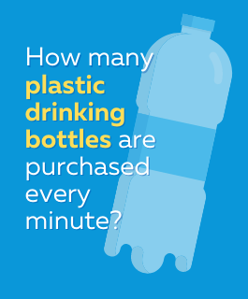
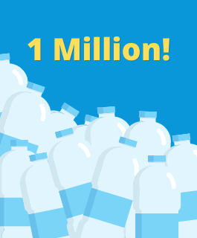
Notes:
Slide Directions:
Show the question slide and read aloud.
Allow time for student answers.
Click to fade in the answer slide and read aloud.
If desired, have a short discussion on this point.

Slide 2
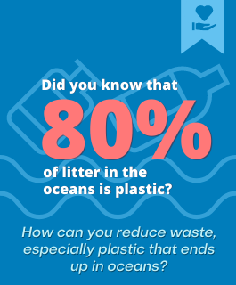

Notes:
Slide Directions:
Show the question slide and read aloud. Be sure to highlight the “How can you …”
Allow time for student answers.
Click to fade in the answer slide and read aloud.
If desired, have a short discussion on this point or share this general talking point:
From the data that you just saw, you can see that there is a global problem with plastic in the ocean – it’s the most common form of marine debris – and come from a variety of sources including plastic water bottles. Using renewable bottles is one solution.
Do you want to learn more about taking action and becoming a hero for global change?

Slide 3
Introduction
Notes:
Slide direction: Insert text, photos or any assets to describe who you are and what you do.
Hello, my name is _______ and I am a _________ at SAS. SAS is part of the Data for Good movement, which encourages using data in meaningful ways to solve humanitarian issues – poverty, inequalities, climate change.
Today, I am going to introduce you to GatherIQ, a free resource from SAS that uses analytics to support the efforts of nonprofits, partners and a growing community of citizens curious about making a difference.

Slide 4
GatherIQ
An interactive resource for world changers – like YOU!
United Nations’ Sustainable Development Global Goals (SDGs)
How you can make an impact
Partners
Notes:
GatherIQ is an interactive resource for world changers, like you.
Who has heard of the Sustainable Development Goals or Global Goals? You’ll learn about the 17 Sustainable Goals outlined by the United Nations. These Global Goals are a blueprint to achieve a better and more sustainable future for all by 2030. They address global challenges like poverty, inequality and climate change. This means that 193 countries around the world agreed that the world has some big problems and it's time for us to all work together to help solve them for a better future. By using GatherIQ you can be part of the solution too by learning about the issues, sharing the facts, and finding actions that you can do to make an impact.
You’ll also learn how you and others can do your part to make an impact.

Slide 5
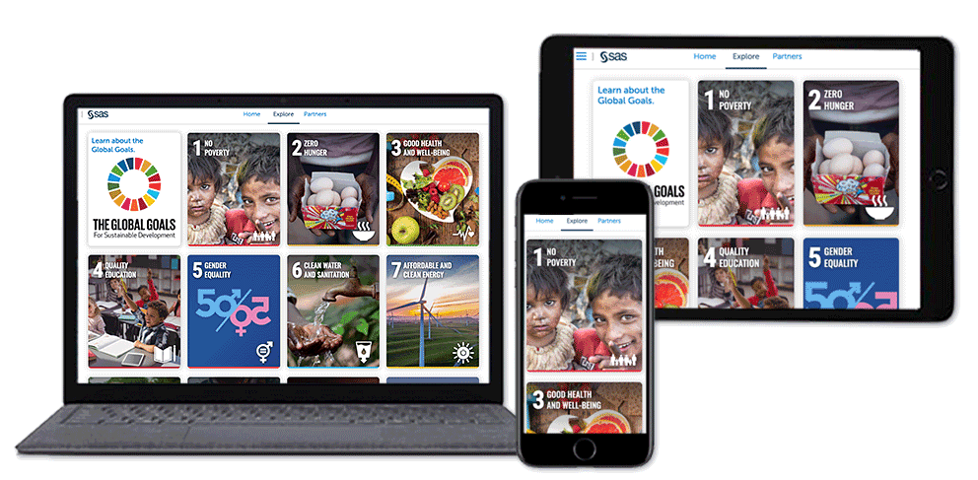
GatherIQ
Notes:
GatherIQ is available on the Web or through the Apple App Store.
The more you move through it, the more you will gain a better understanding of global issues, challenges and solutions.
You’ll find powerful stories and relevant data about the people and organizations who are making a difference.

Slide 6
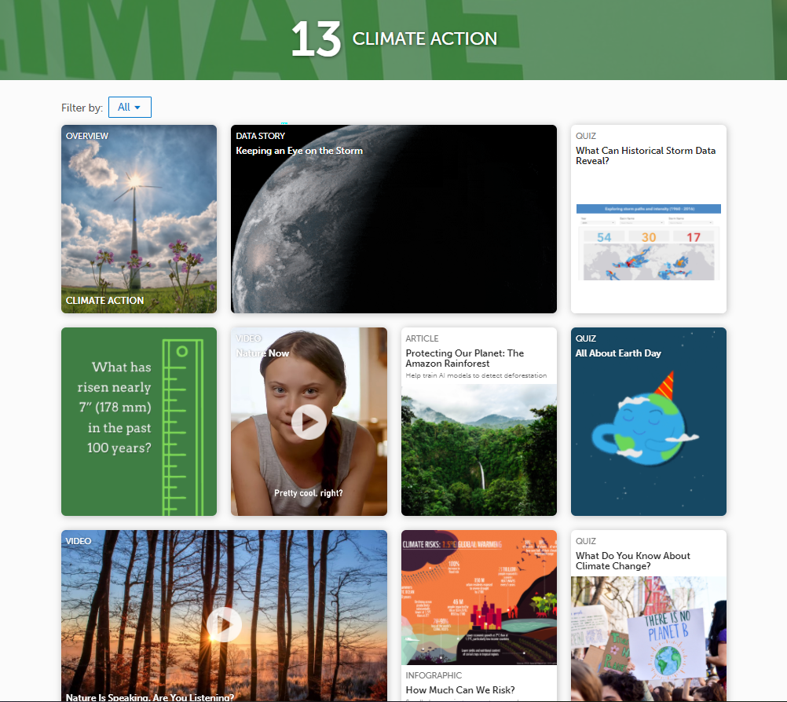
GatherIQ Features
Notes:
Each goal is full of dynamic, interactive visualizations that tell the story beyond numbers. Watch videos, listen to podcast, and read articles to increase your awareness. You can also complete polls to give your opinion and take quizzes to test your knowledge.
Here’s a hint: Use Filter to find our Do Good tiles that highlight ways to take action on the Global Goals.

Slide 7
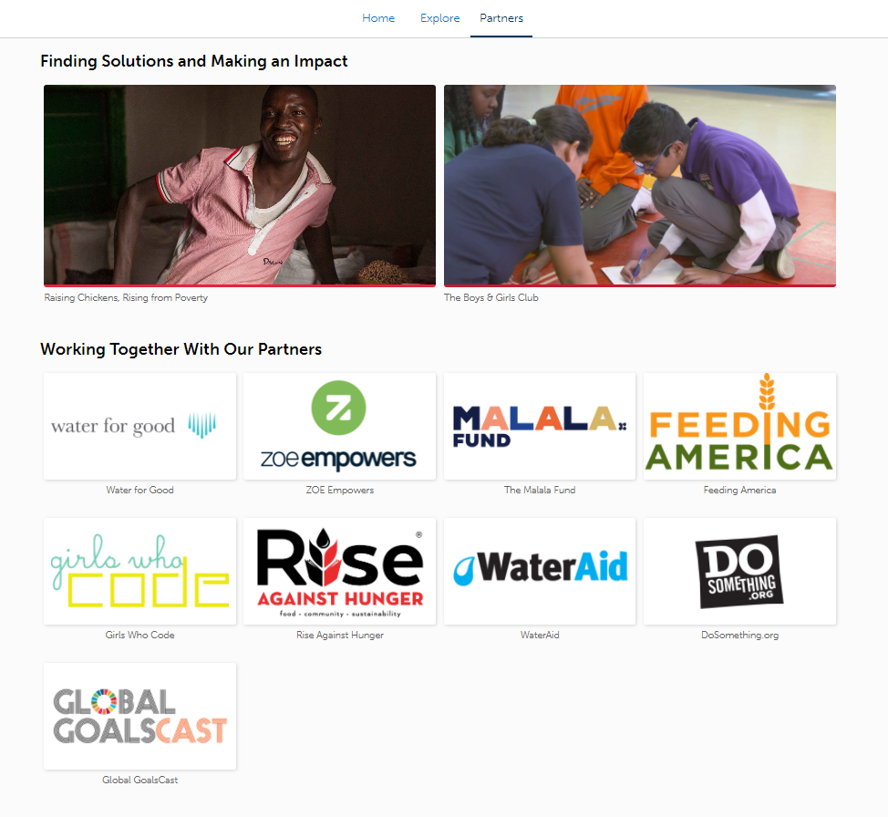
GatherIQ Partners
Notes:
SAS has partnered with organizations around the word that are working on the frontlines to help solve global issues. Look through GatherIQ to read their stories, learn about the people and places that they help, and engage with them on social media.

Slide 8
Go Explore!
Consider these questions
  What are you passionate about? What goal interest you?
  What are some of the issues in that goal?
  What are some solutions?
Explore Gather IQ (https://app.gatheriq.analytics/home).
Find a goal or topic you would like to learn more about and answer the questions.
Notes:
Now it’s your turn to explore GatherIQ.
Consider the questions as you move through the product.
Go to the site and start exploring.
If possible, share your findings with others.

Slide 9
Get Involved!
Share on social media @GatherIQ #GatherIQ.
Recommend a new topic or action.
Participate in our outreach events.
Video
Notes:
Slide Directions, select Video to show a promotion for social sharing and GatherIQ - https://youtu.be/MIKg6Y2Gt6M
There are a variety of ways you can support the Global Goals. Get involved and raise awareness! You too can be a hero for the Global Goals by taking action – volunteer, donate or share ideas with others on social media. Don’t forget to mention @GatherIQ or #GatherIQ.

